Slide 1

Python
Pandas – Project2
Carprice

Slide 2
car price
Analyse the below car price dataset using Python to find meaningful insights
Data Insights:
Problem Statement: Our friend Otis wants to sell his car but isn't sure about the price. He wants to maximize profit while ensuring a reasonable deal for buyers. To help Otis we will analyze the dataset and determine the factors affecting car prices.

Slide 3
Step1:
Import libraries
import pandas as pd
import numpy as np
import matplotlib.pyplot as plt
Load CSV file to a dataframe

Slide 4
Step2:
Data Cleaning and preparation
Check for missing values
df.isna().any()
df.isnull().sum()
Observation2:
Convert MPG to L/100KM
Solution: 235.214583 / mpg
Convert price column to integer
Solution: The price column should be integer, but it has some ‘?’. So replace ‘?’ with 0, convert it to int data using astype(int)
Normalize price column

Slide 5
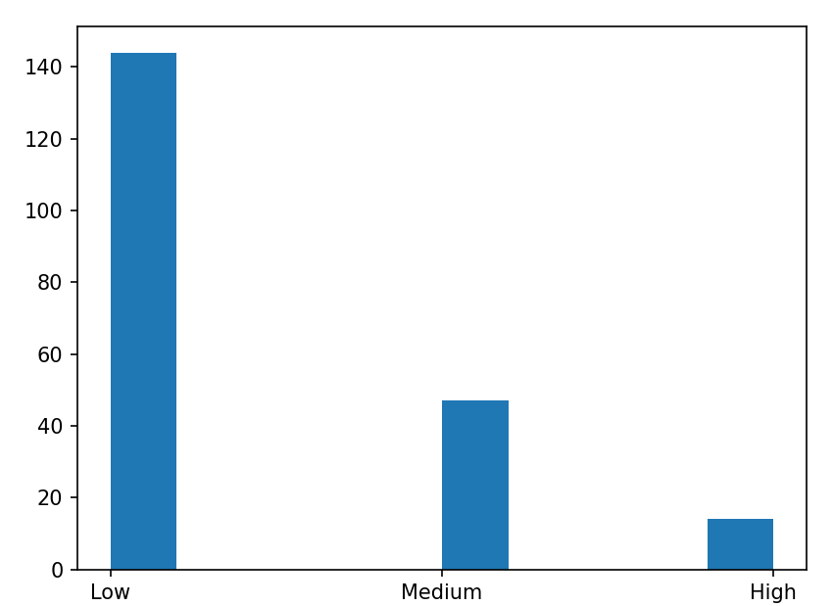
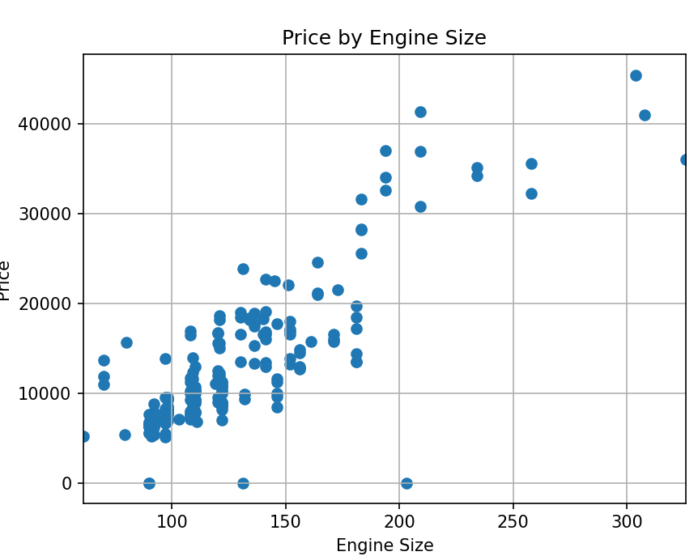
Step3 – Data Insights
Price Binned
bins = np.linspace(min(data['Price']), max(data['Price']), 4)
group_names = ['Low', 'Medium', 'High']
data['Price-binned'] = pd.cut(data['Price'], bins, labels=group_names, include_lowest=True)
plt.hist(data['Price-binned'])
plt.show()
Engine size vs. price scattered chart
plt.scatter(df['engine-size'],df['Price'])
plt.grid()
plt.xlim(df['engine-size'].min(), df['engine-size'].max())
plt.show()

Slide 6
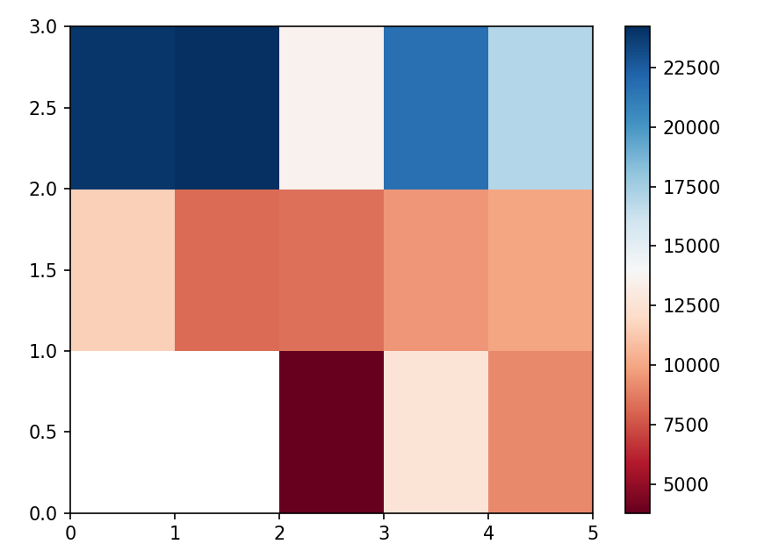
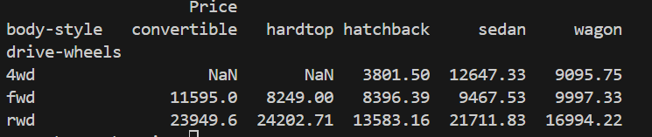
Step3 – Data Insights
3. Pivot and heatmap
data_pivot = data_grouping.pivot(index='drive-wheels',columns='body-style')
plt.pcolor(data_pivot, cmap ='RdBu')
plt.colorbar()
plt.show()
4. Pivot to indicate price across body style and drive wheels
test = df[['drive-wheels','body-style','Price']]
data_grouping = round(test.groupby(['drive-wheels','body-style'],as_index=False).mean(),2)

